Slide 1
Colorado Traffic Stops
Springboard DSC Capstone 2
Lisa Moller

Slide 2
Project Overview
GOAL
Provide police departments and interested groups with a more complete picture of traffic stops in Colorado
May show conscious or unconscious biases
Could help with police training
More information for resource allocation

Slide 3
Dataset
Stanford Open Policing Project: https://openpolicing.stanford.edu/data/.
Partnership between the Stanford Computational Journalism Lab and the Stanford School of Engineering
Starting in 2015, the Open Policing Project began requesting traffic stop data from states. The project has collected and standardized data from 31 states.

Slide 4
Dataset
After removing the ‘raw’ data, there were 18 features and 2,584,744 observations
ID
Stop date
Stop time
County name
Police department
Driver gender
Driver age
Driver race
Violation
Search conducted
Search type
Contraband found
Stop outcome
Arrested
Officer ID
Officer gender
Vehicle type
Out-of-state

Slide 5
Digging In…
First looked at the information present when the stop was made
Second, looked at the actions after the stop

Slide 6
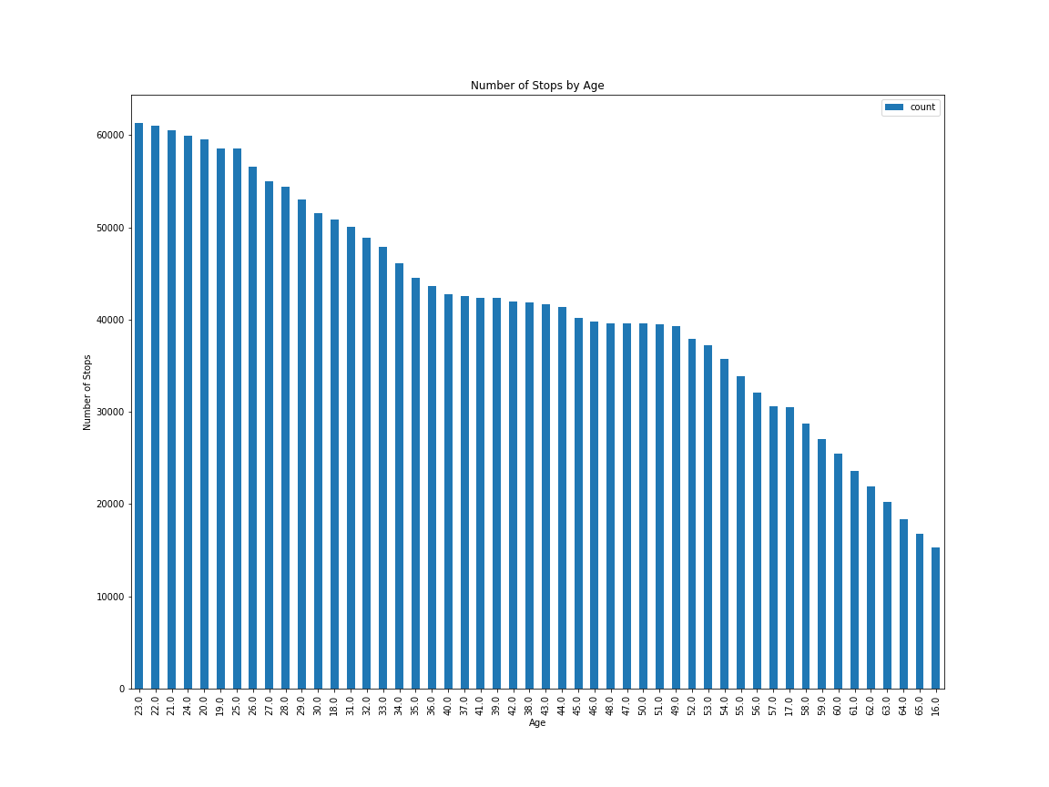
Traffic Stops by Age
Notes:
The top-12 ages stopped are ages 19-30 years old.

Slide 7
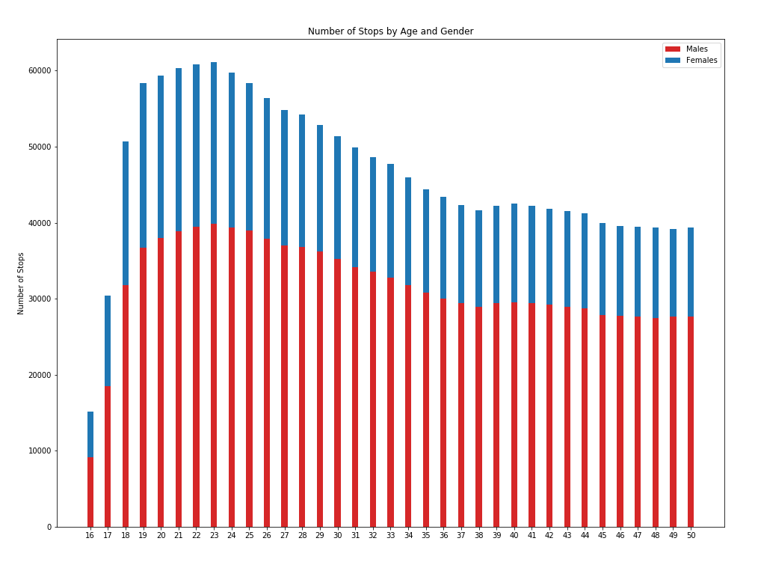
Traffic Stops by Age and Gender
Notes:
More than twice as many males (68.9%) were pulled over than females (31.1%). There is a smaller disparity between men and women who are pulled over in the younger (18-33) age range. Men are 60-65% of the stops, while women are 35-40%. The older group split is closer to 70% men and 30% women.

Slide 8
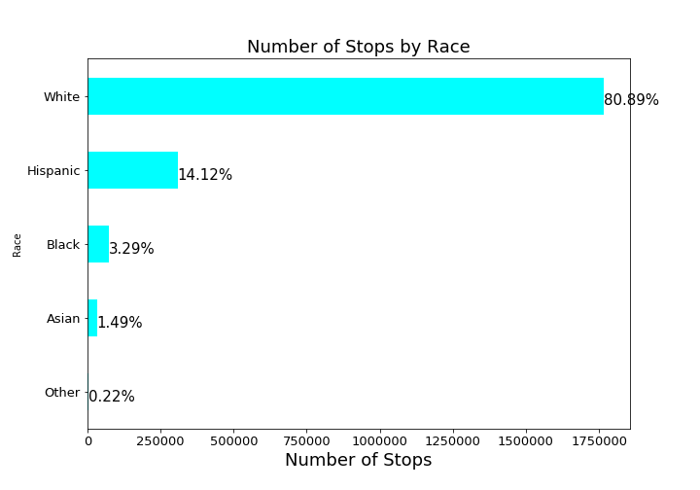
Traffic Stops by Race
Notes:
The percentages by race for drivers pulled over looks to be fairly close to the demographics of Colorado. Wikipedia Colorado demographics: 81.3% White American (70.0% Non-Hispanic White, 11.3% Hispanic white) 20.7% Hispanic and Latino American (of any race) heritage 7.2% Some Other Race4.0% Black or African American 3.4% Multiracial American 2.8% Asian American 1.1% American Indian and Alaska Native 0.1% Native Hawaiian and Other Pacific Islander.

Slide 9
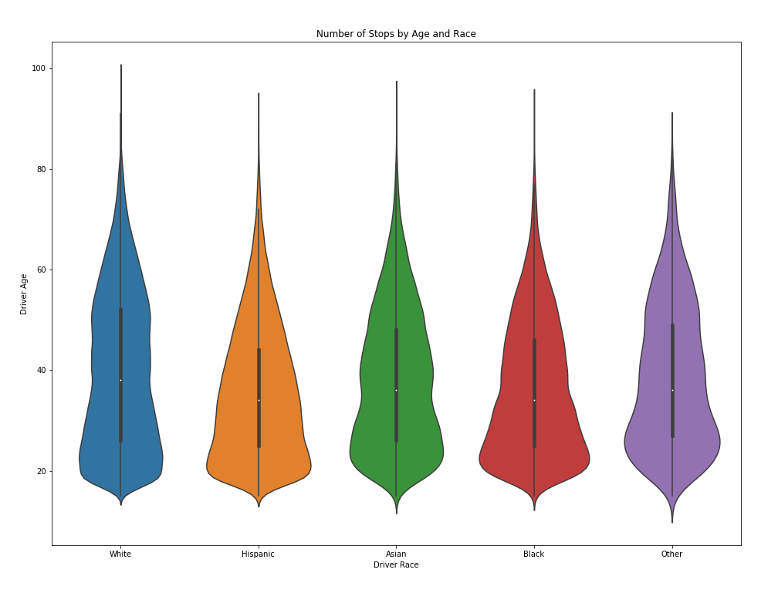
Traffic Stops by Age and Race

Slide 10
What Else?
The top 2 counties where people were pulled over made up almost 16% of the traffic stops.
El Paso County – I-25 and Colorado Springs
Jefferson County - major entrance to the mountains
Speeding accounted for over 36% of the traffic stops
The vehicle type was mostly not tracked. Over 70 of the data had the vehicle type recorded as 'NA NA 0' or 'NA NA NA’
Out-of-State drivers accounted for 18% of the stops
Golden’s police department accounted for almost 11% of the stops.
Denver is the capital city of Colorado, but a very small portion of the stops (less than 1%).
Stanford Open Policing Project states: “Denver County has many fewer stops than expected given the residential population; this is because it only contains a small section of highway which is policed by the state patrol.”

Slide 11
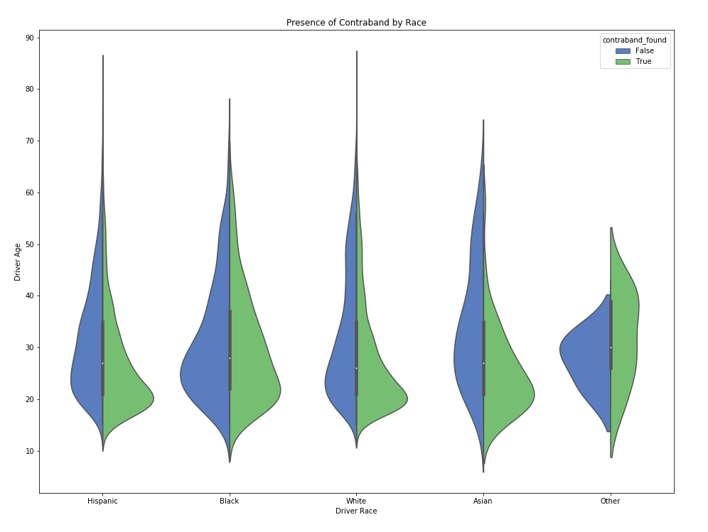
Was Contraband Found?

Slide 12
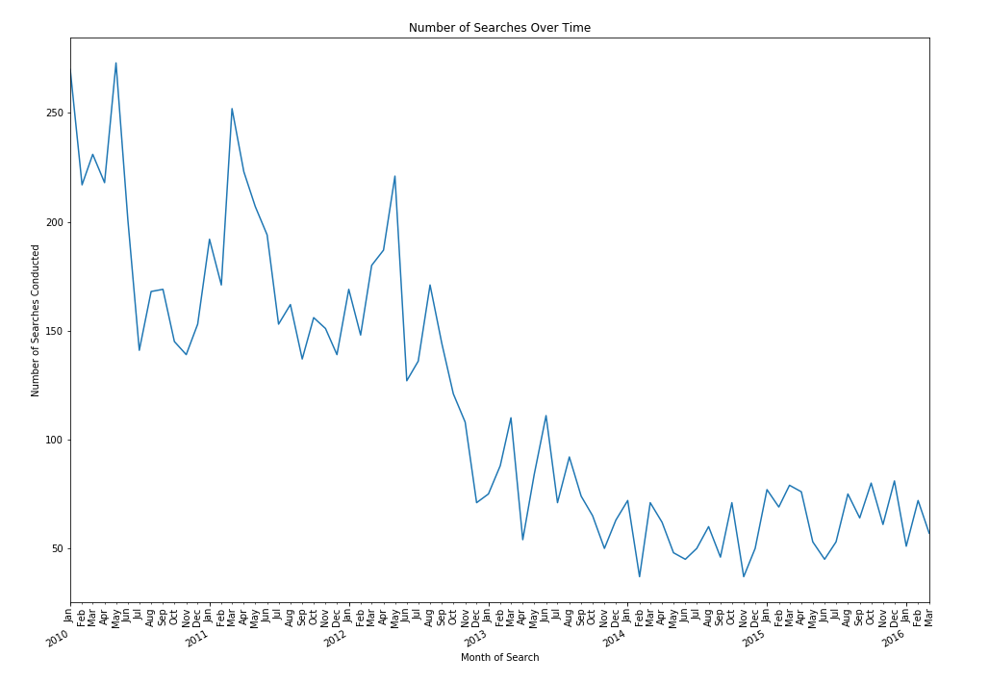
Searches Over Time

Slide 13
Statistical Inference
Is there a statistically significant difference in the mean ages between the genders?
Males: 39.68
Females: 37.56
Z-statistic
p-value - .075 = did not reject the null hypothesis (that the mean age of males and females who are stopped are the same)
the difference in the mean ages of males and females is not statistically significant

Slide 14
Machine Learning
K-Means Clustering
Large Dataset!
10 features - Categorical features, so we used get_dummies()
First subset: top 11 violations contained 80% of the data
Second subset: keep features present before and up to the stop. We removed ‘search_conducted’, ‘contraband_found’ and ‘is_arrested’

Slide 15
Machine Learning
Elbow method to choose the number of clusters
Cluster | Number of Observations
3 | 513,971
1 | 461,478
0 | 388,161
4 | 232,652
2 | 112,946

Slide 16
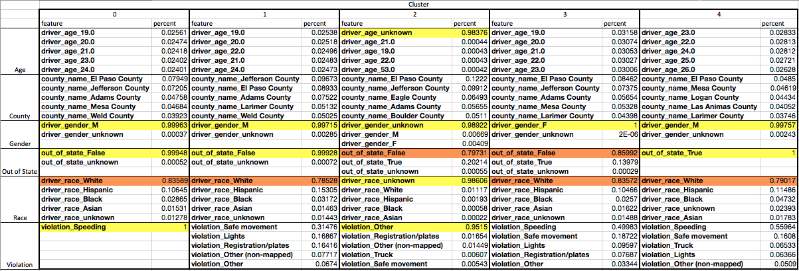
Machine Learning

Slide 17
Machine Learning
Main influencers…
gender
in/out-of-state status
Violation
This makes sense given that we saw in the exploratory analysis
Race = white
Age = young
County = El Paso or Jefferson

Slide 18
Evaluation/Recommendations
Colorado police departments invest in a structured data collection and analysis*
There are questions about who participated in supplying the current data, and there are issues with completeness of the data (null or NA values)
Further results could also be compared to census data to understand whether the results are proportional to the state population

Slide 19
*they are!
“Denver Police Will Launch Program to Collect Racial Data on People During Stops” June 13, 2018
https://www.denverpost.com/2018/06/13/denver-police-racial-data-project/

Slide 20
Next Steps/Improvements
Try a different method to choose the number of clusters in the model, such as the silhouette score
Another method for clustering, such as DBSCAN. DBSCAN focuses on dense regions of the data and may find more insightful patterns in the data
Better data

Slide 21
Questions?

